Slide 1
An Introduction to MCM
---Based on paper Multiplier-less Multiple Constant Multiplication

Slide 2
Content
How multiplier was done in computer
Variable multiply a constant number
SCM (Single Constant Multiplication)
Digital based recording
CSD (Canonical signed digit)
MCM (Multiple Constant Multiplication)
To describe the question
MCM algorithms

Slide 3
Multiplication in computer
The pencil and paper work of the binary multiplication
10111 Multiplicand
X 10011 Multiplier
10111
10111
00000
00000
10111
110110101 Product

Slide 4
Multiplication in computer
Hardware Multiplication
10111 Multiplicand
10011 Multiplier
00000 Initial partial product
10111 Add multiplicand, since multiplier bit is 1
10111 Partial product after add and before shift
010111 Partial product after shift
10111 Add multiplicand, since multiplier bit is 1
000101 Partial product after add and before shift
1000101 Partial product after shift
01000101 Partial product after shift
001000101 Partial product after shift
10111 Add multiplicand, since multiplier bit is 1
110110101 Partial product after add and before shift
0110110101 Product after final shift

Slide 5
Multiplication in computer
Multiplicand
Register B
Cout
Parallel adder
Multiplier
0
C
Shift Register A
Shift Register Q
Product
Fig.1 Hardware implementation

Slide 6
Single constant multiplication (SCM)
- A multiplication by a fixed-point constant can be done “Multiplier-less” using additions and shifts only.
For example: y = 5x ----.>
x
X
CX
cx
Fig 2. SCM box
Multiplier block
y = (x<<2) + x

Slide 7
SCM- How to find a multiplier block
The crucial stage is to decompose the multiplication into adds and shifts. Like the example,
y =
The straightforward(digital-base) method :
71x = 1000111x = x<<6 + x<<2 + x<<1 + x
(x<<2) + x
Translate 1’s in the binary representation of the constant C into shift, add adds up the shifted inputs
Need b/2 + O(1) adds, b is the bit-width of C

Slide 8
Method to find the multiplier box
-Alternatively,
71x =1000111x= (x<<7 - x) – x<<5- x<<4 – x<<3
Translate 0’s in the binary representation of the constant C into shift, subtracts from the closest constant.
Need b/2 + O(1) adds, b is the bit-width of C

Slide 9
Method to find the multiplier block
Canonical signed digital (CSD)
71x =1000111x= 1001001x = x<<6 + x<<3 - x
Decomposed into both adds and subtracts
Need b/3 + O(1) adds or subtracts , on average

Slide 10
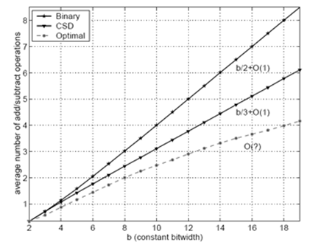
Method to find the multiplier block
The digital based recording or CSD are not the optimal approach.
For example:
CSD: 65x = x + 64x
49x = 65x – 16x
45x = 49x – 4x
Optimal:
9x = 8x + x
45x = 5(9x) = 9x + 4(9x)
Fig 3.Contrast on Digital – CSD -- Optimal

Slide 11
Topology graph of multiplier block
-4
CSD: 65x = x + 64x
49x = 65x – 16x
45x = 49x – 4x
- Optimal: 9x = 8x + x
45x = 9x + 4(9x)
-16
64
1
65
49
45
1
1
1
45x = x + 64x – 16x – 4x
8
4
1
1
9
1
45
45x = (x + 8x) + 4(x + 8x)
Fig 4. Topology graph of multiplier block

Slide 12
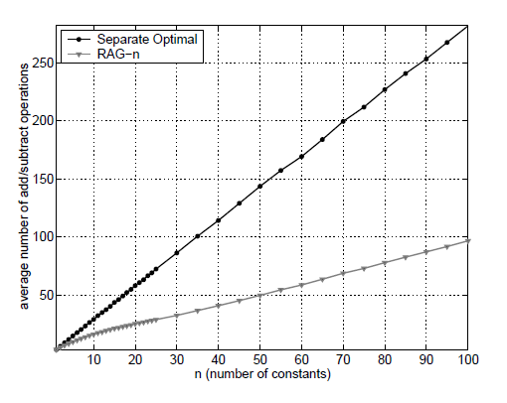
MCM
Fig 5. MCM block
MCM is an extension of SCM. Multiplying a variable x by several constants, x1, x2, x3 … xn, in parallel, in a so-called multiplier block
Since intermediate results may be share, so we can reduce operations when comparing to separate SCMs.
Our problem is to find the decomposition
for the MCM with the fewest operations
CX
c1x
CX
c2x
x
x
X
X
CX
CX
CX
cnx
Fig 6. Add/Subtract number, bit-width is 12

Slide 13
MCM
Example
y1 = 23x
y2 = 81x
Y1 = 32x – (8x + x)
Y1 = 8(8x + x) + (8x + x)
32
8
1
9
23
1
-1
8
1
81
Fig 7. An example for MCM topology graph

Slide 14
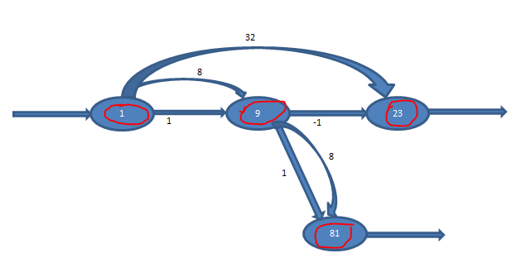
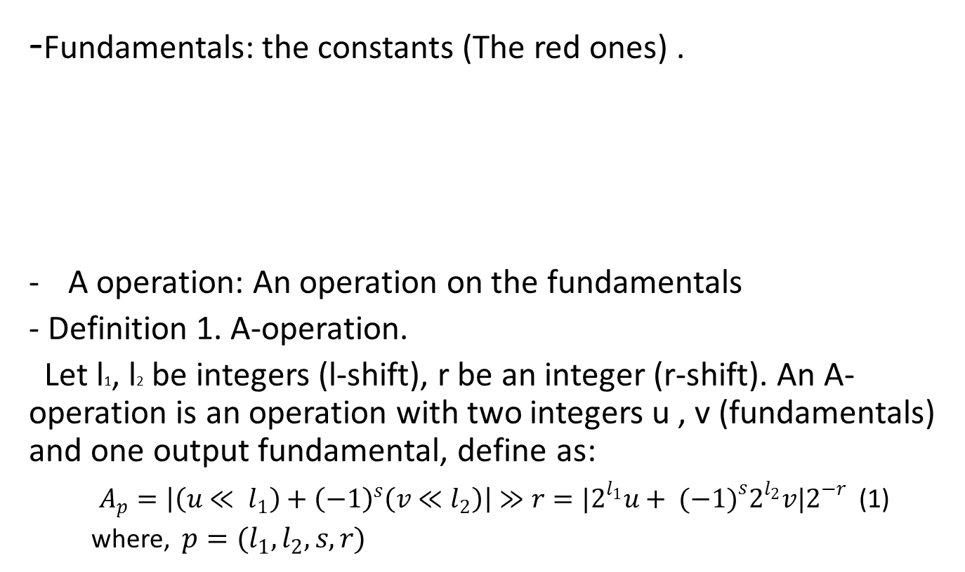
MCM– A operation
-Fundamentals: the constants (The red ones) .
A operation: An operation on the fundamentals
- Definition 1. A-operation.
Let l1, l2 be integers (l-shift), r be an integer (r-shift). An A-operation is an operation with two integers u , v (fundamentals) and one output fundamental, define as:
$A_{p}=\left|\left(u≪ l_{1}\right)+{\left(−1\right)}^{s}\left(v≪l_{2}\right)\right|≫r=|2^{l_{1}}u+ {(−1)}^{s}2^{l_{2}}v|2^{−r}$ (1)
where, $p=(l_{1}, l_{2},s,r)$
Fig 8. Fundamentals

Slide 15
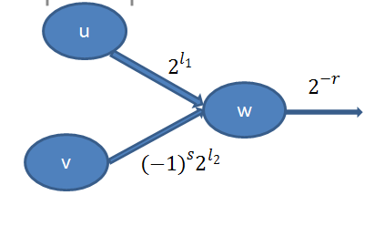
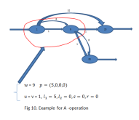
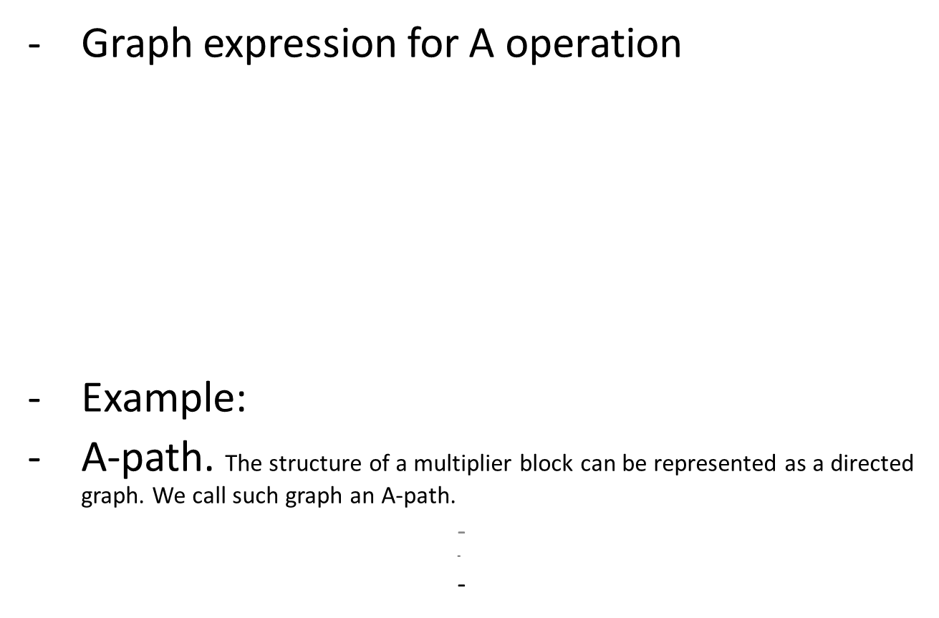
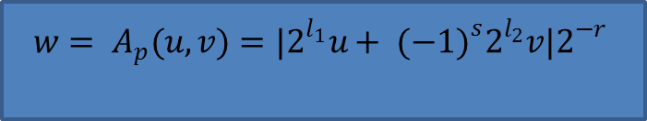

MCM- A operation
Graph expression for A operation
Example:
A-path. The structure of a multiplier block can be represented as a directed graph. We call such graph an A-path.
$$p=(l_{1}, l_{2},s,r)$$
$${w= A}_{p}(u,v)=|2^{l_{1}}u+ {(−1)}^{s}2^{l_{2}}v|2^{−r}$$
Fig 9. Graph expression for the A-operation

Slide 16
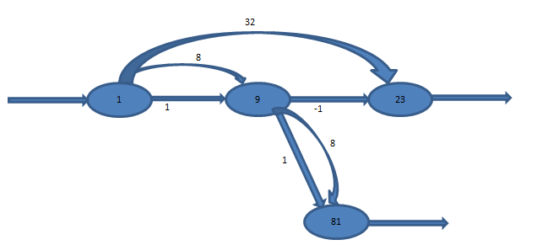

MCM- Formal problem statement
Definition 2. MCM problem.
Given a set of positive target constants $T=\{t_{1},t_{2}, t_{3}, t_{4}, …, t_{n} \}$, Find the smallest set $R=\left\{r_{0}, r_{1},r_{2}, r_{3}, r_{4}, …, r_{m}\right\} with T ⊂R$, such that $r_{0}$ = 1, and for all $r_{k}$ with 1 ≤ k ≤ m there exist $r_{i}$ , $r_{j}$ with, 0 ≤ i ≤ j < k, and an A – configuration $p_{k}$ that
$r_{k}={A_{p}}_{k}(r_{i},r_{j})$ (2)
Build a A-path upon R.
Example:
T = {23, 81}
R= {1, 9, 23, 81}

Slide 17
Summary
General multiplication in computer.
The SCM.
Multiplier block
How to find the MB
Topology graph for MB
The MCM
A-operation
A–path
The formal statement of MCM problem

Slide 18
Continue contents
Algorithms for MCM problem
Digital based recoding
Common sub-expression elimination
Graph based algorithms
Hybrid algorithms (RAG-n)

